Slide 1



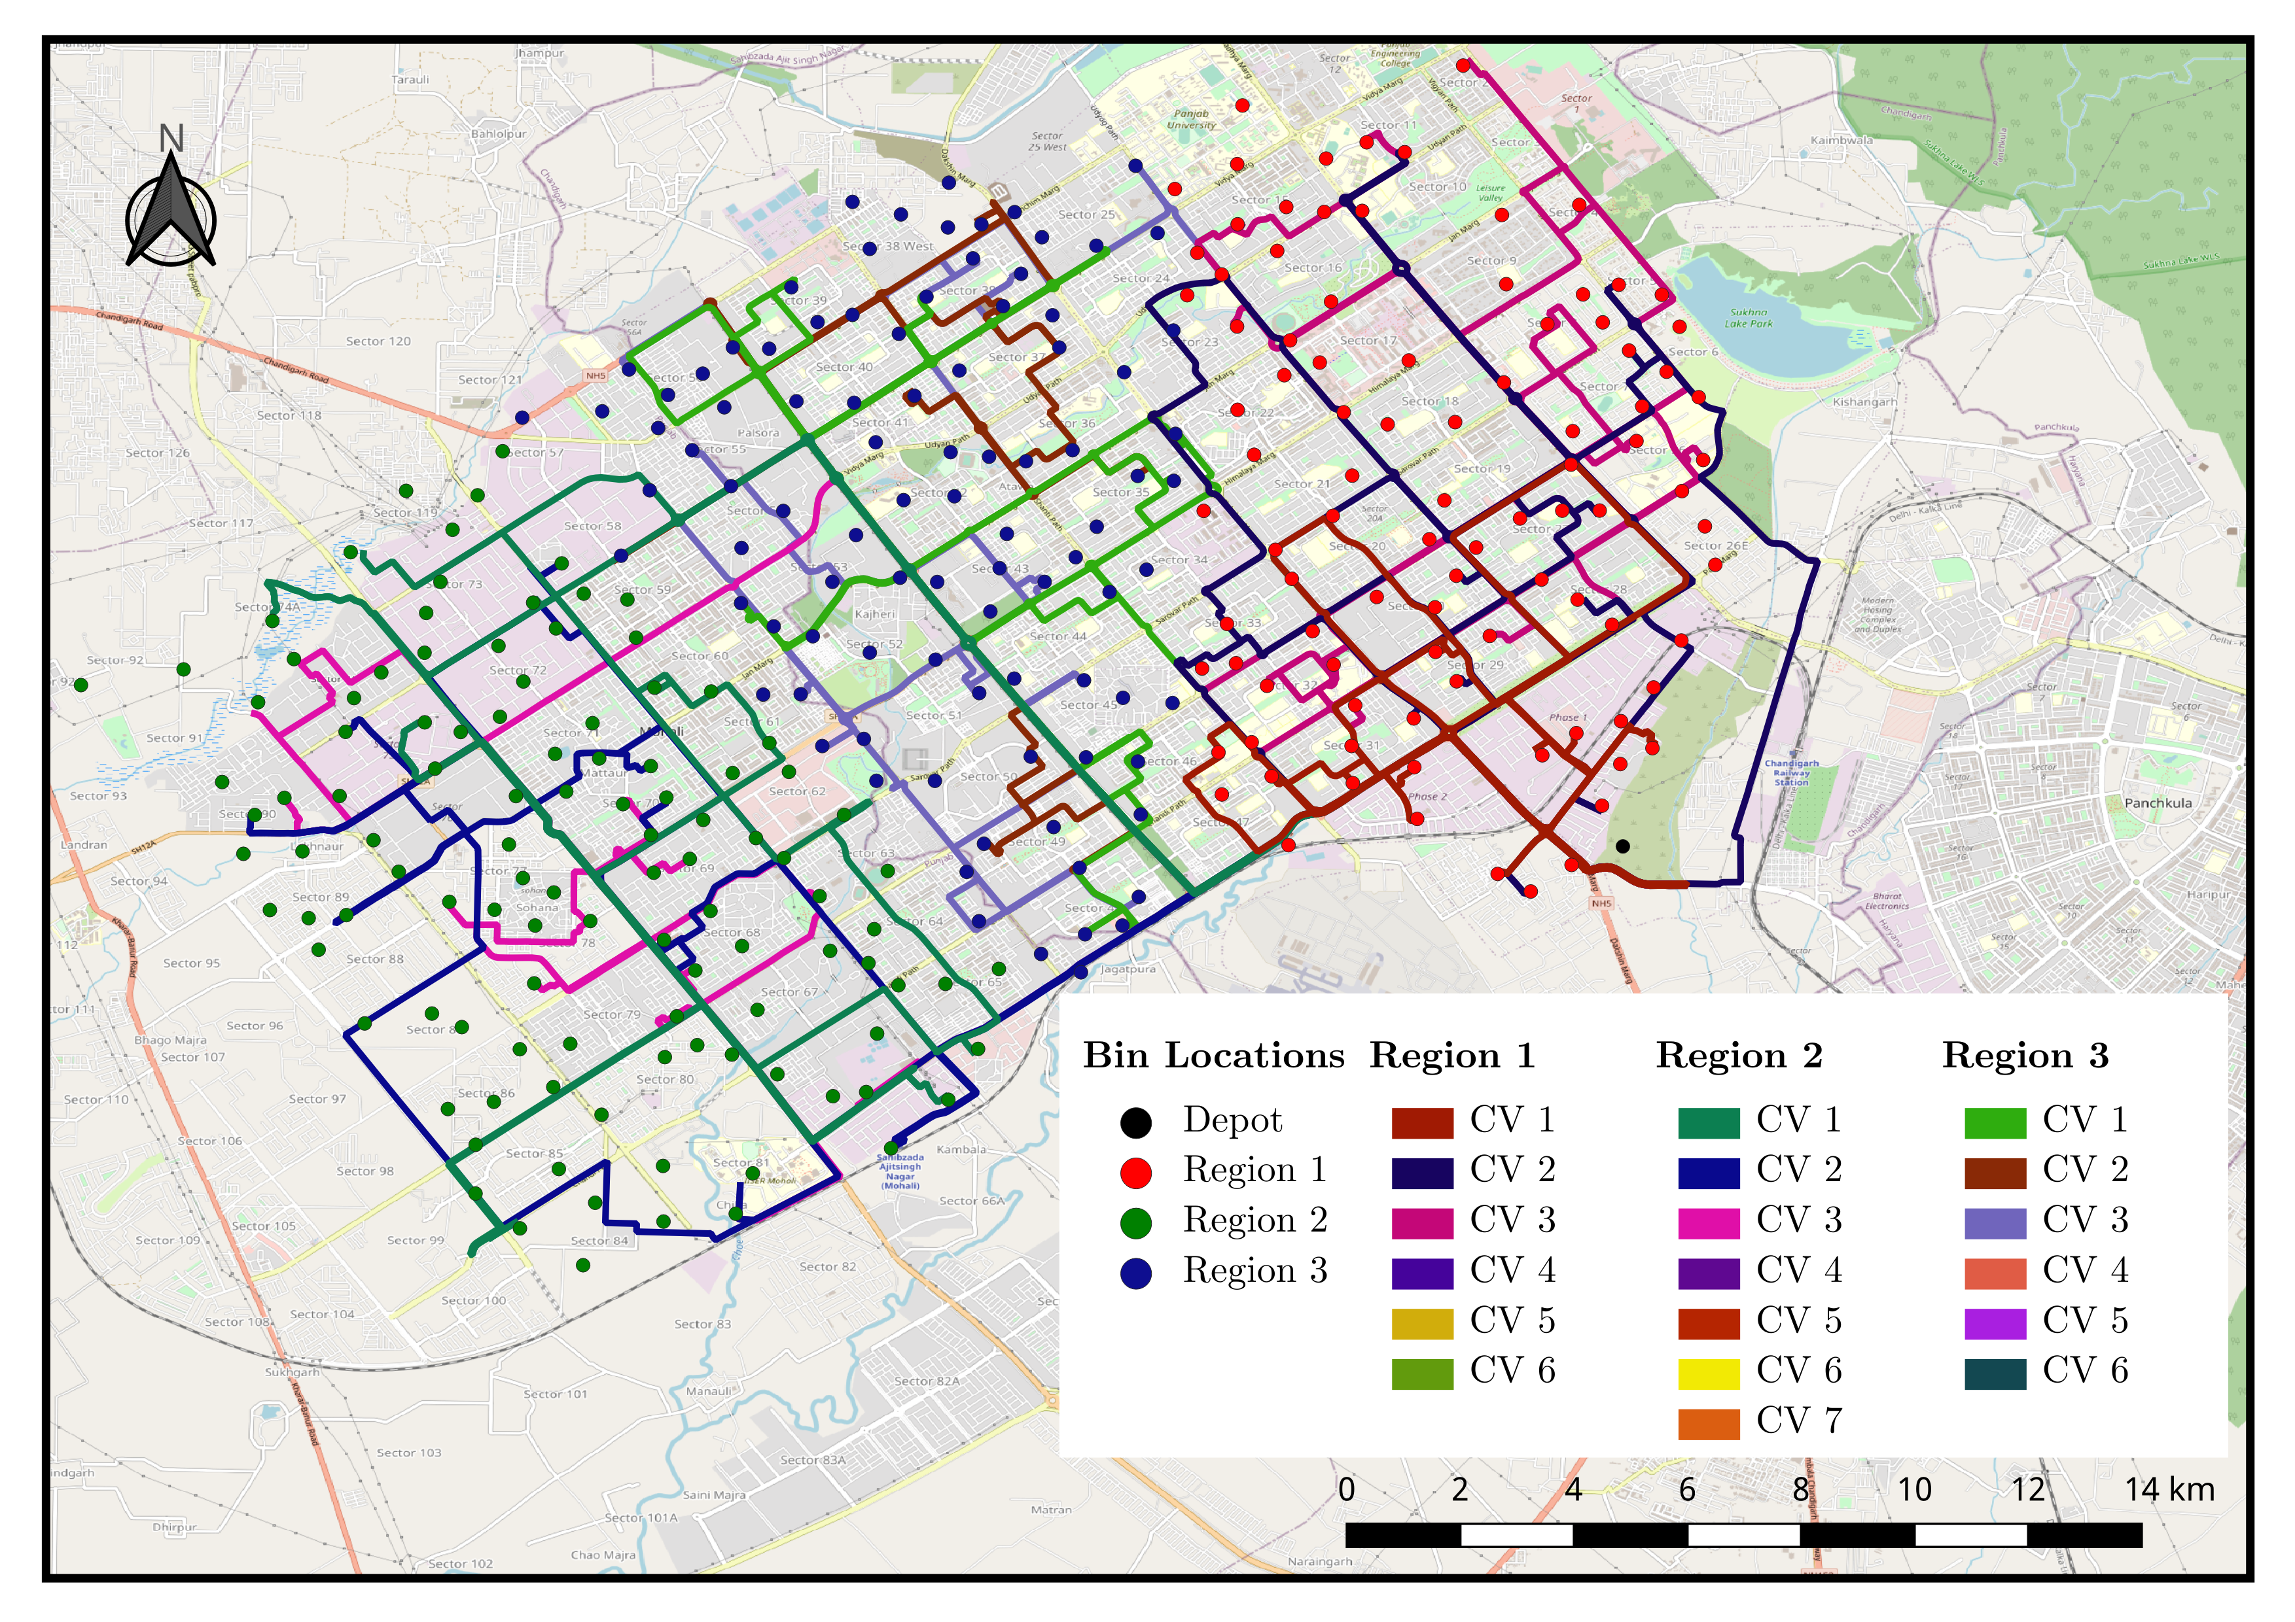
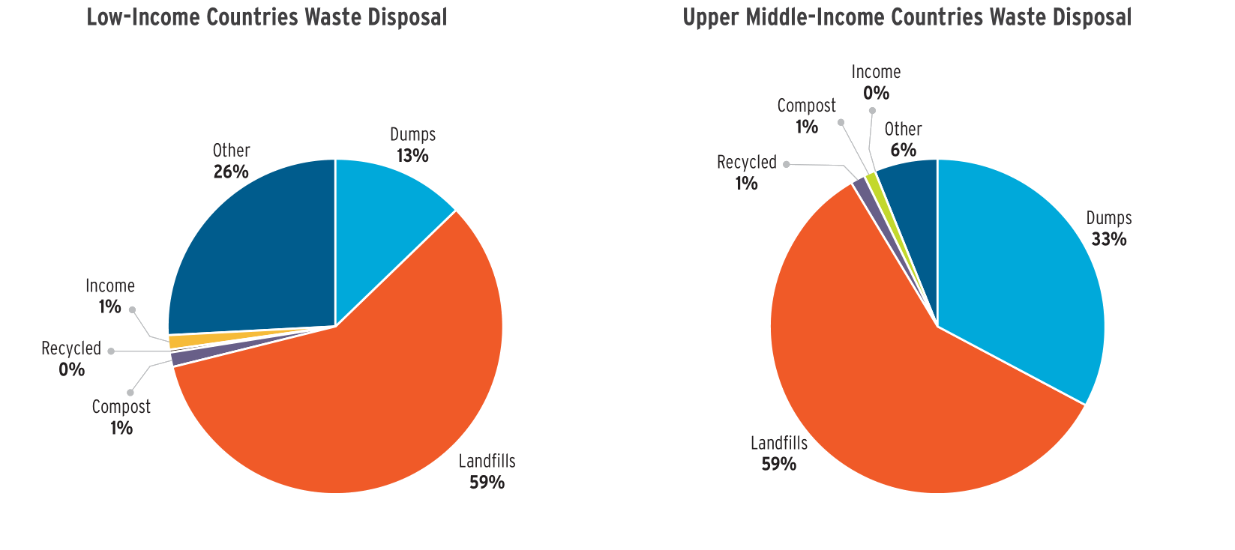
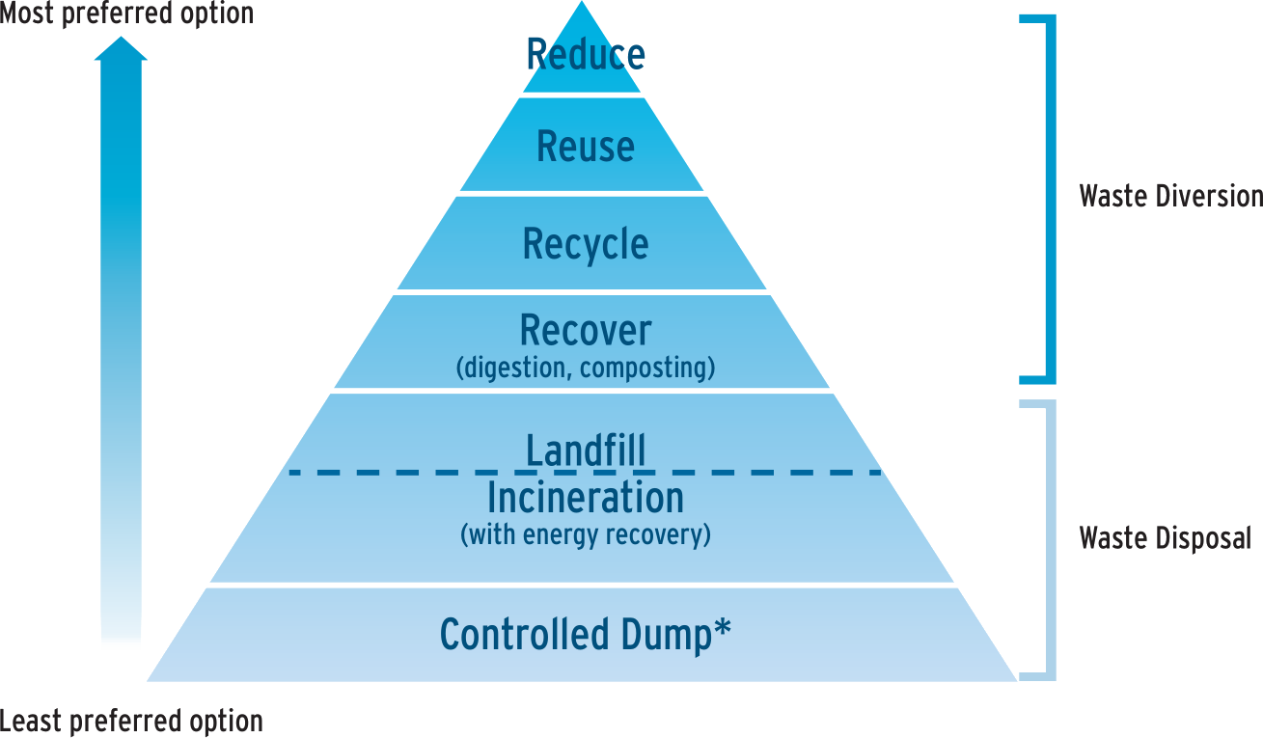
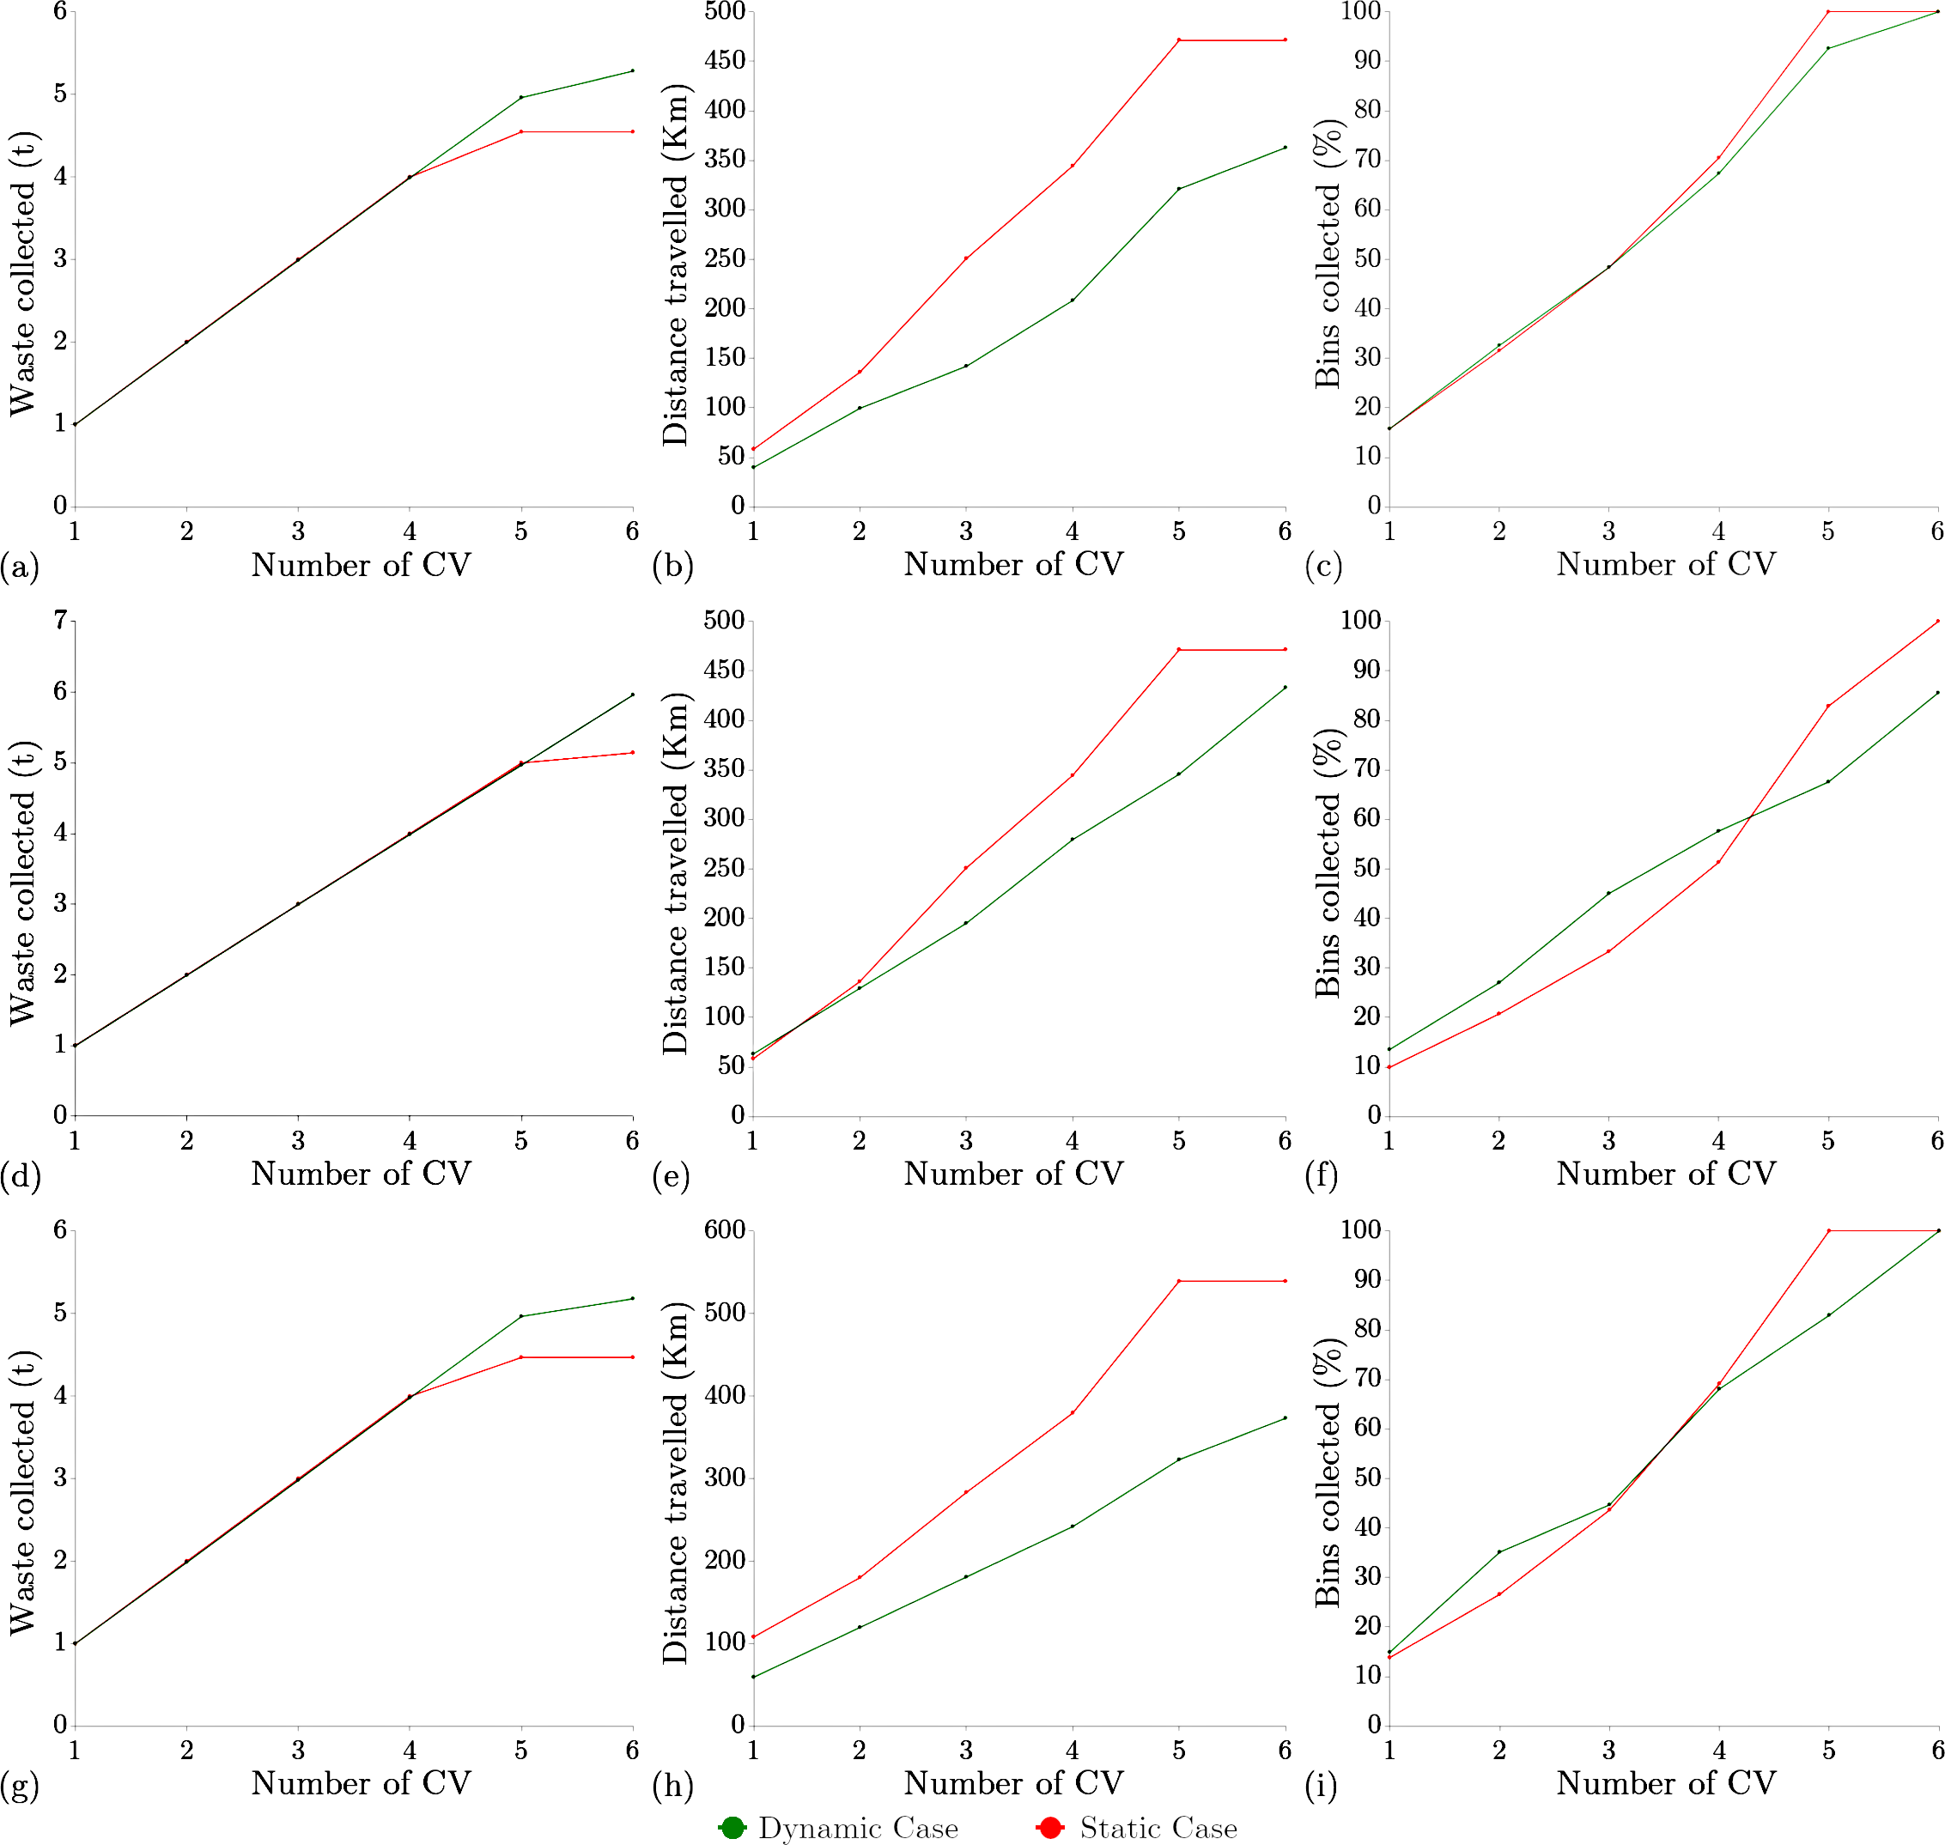
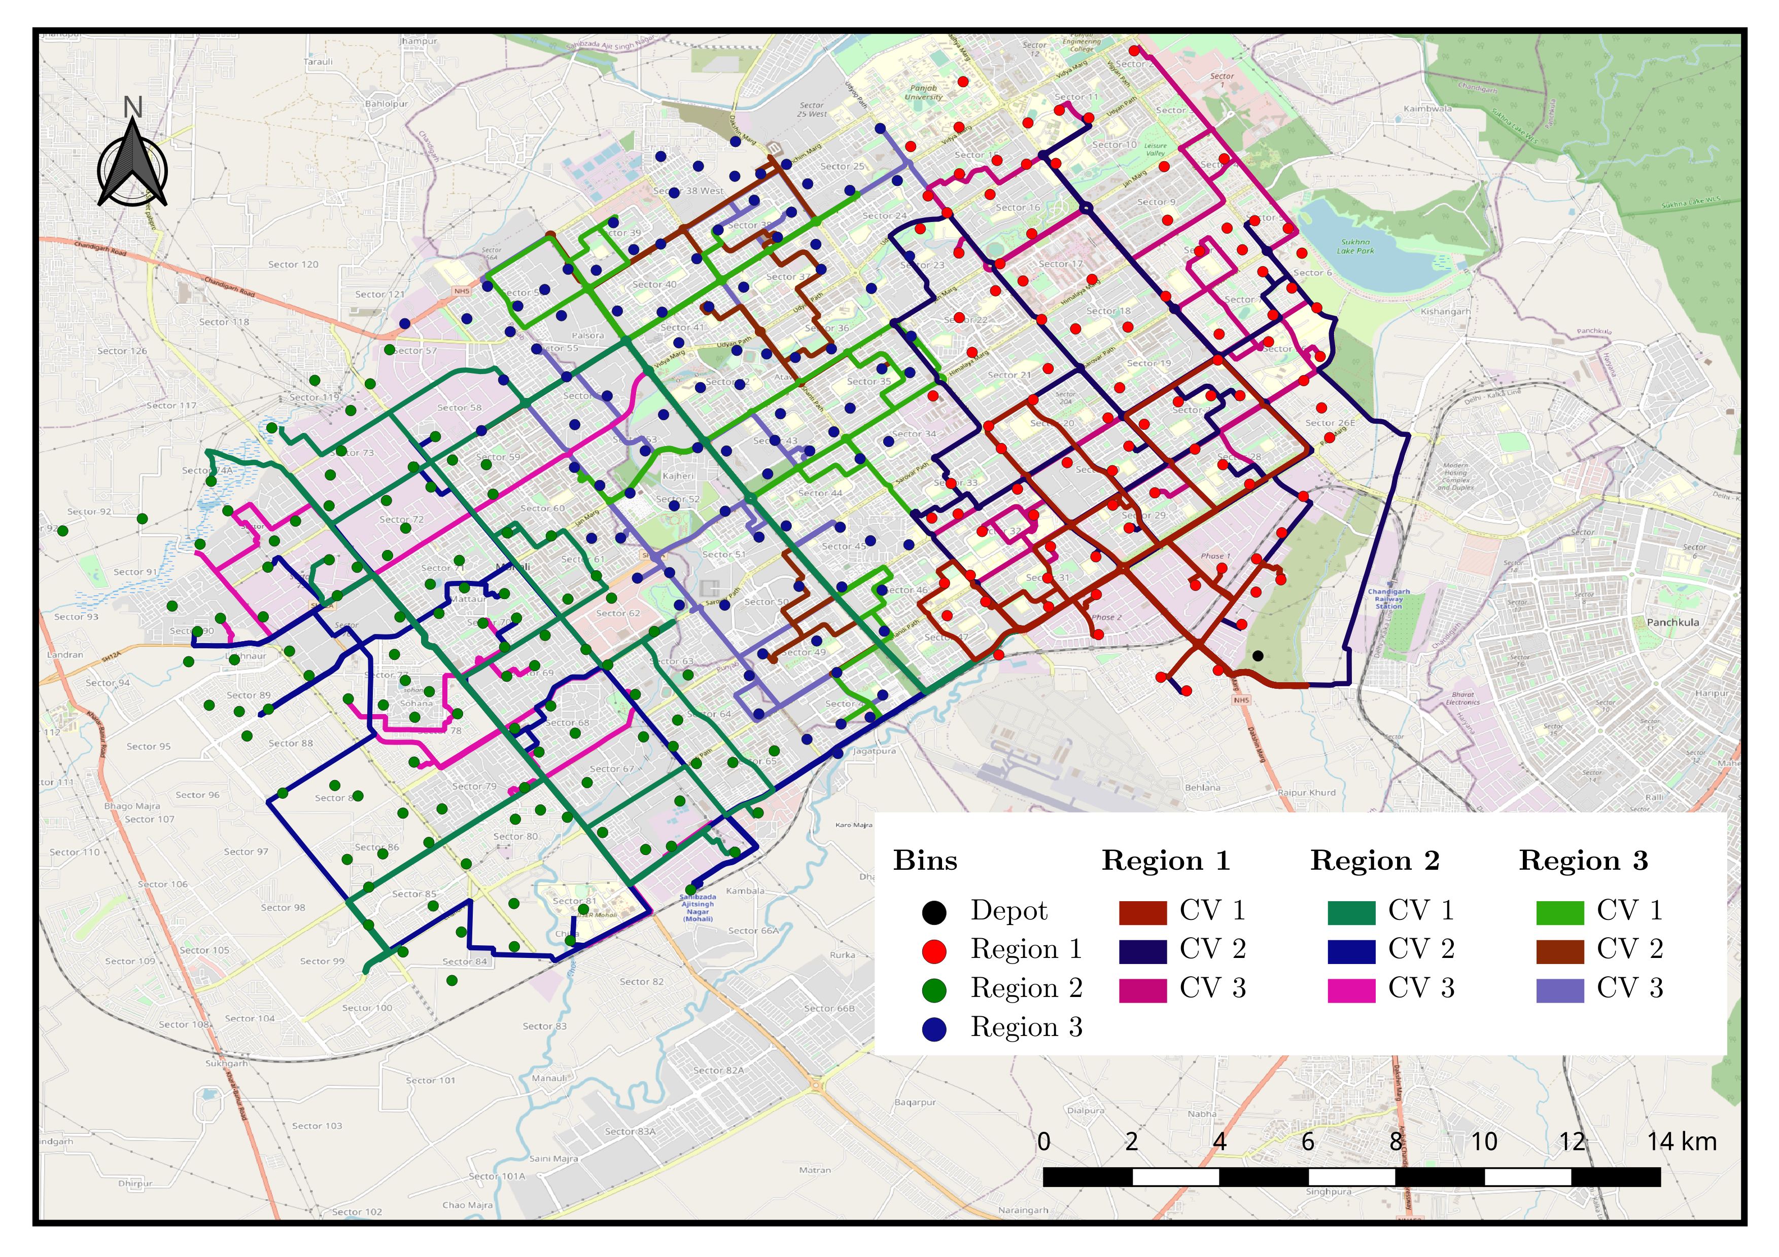
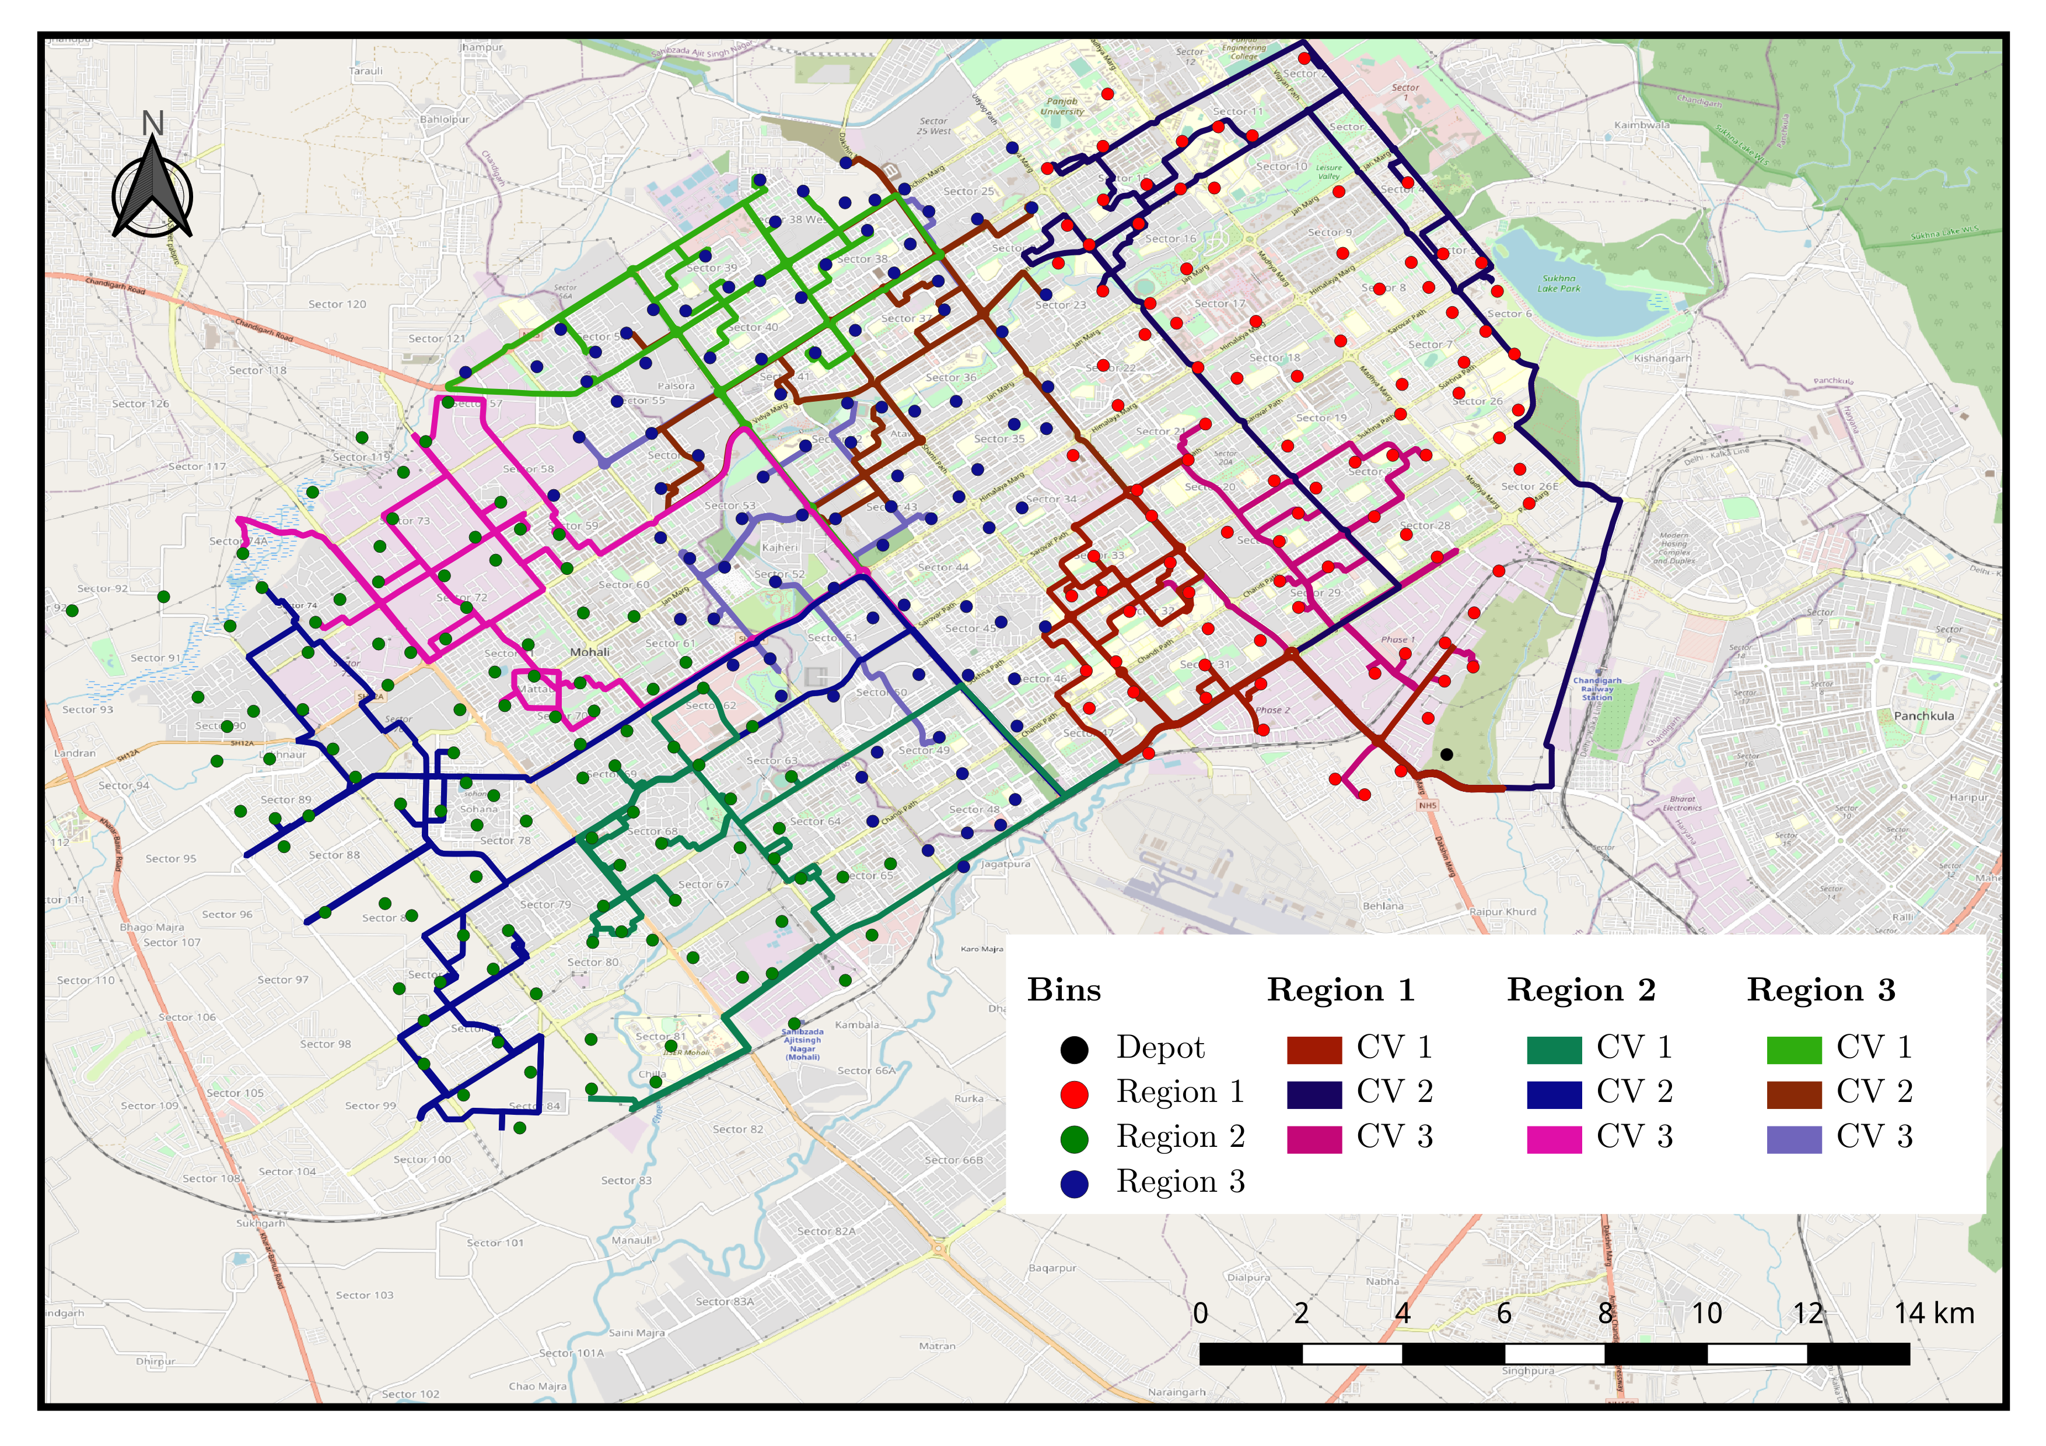
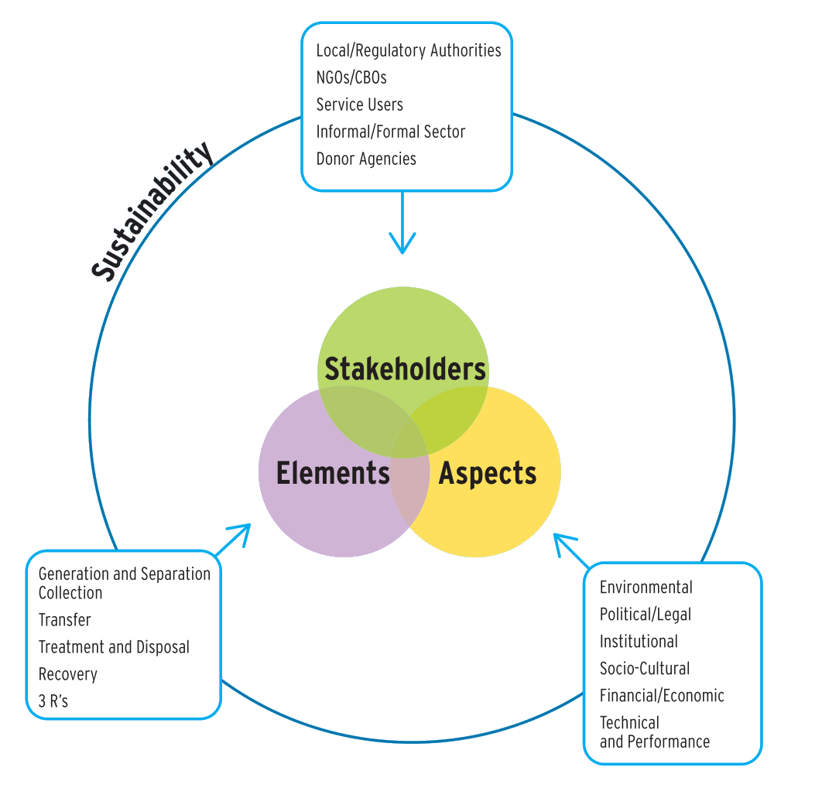
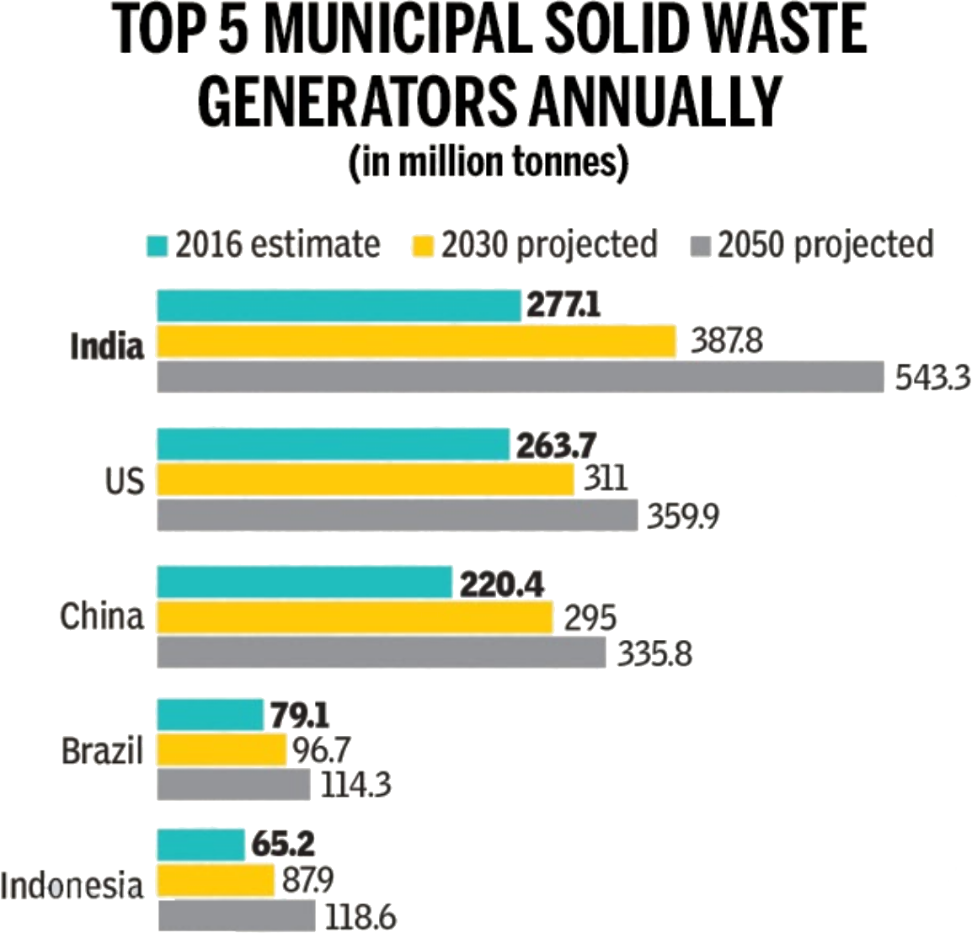
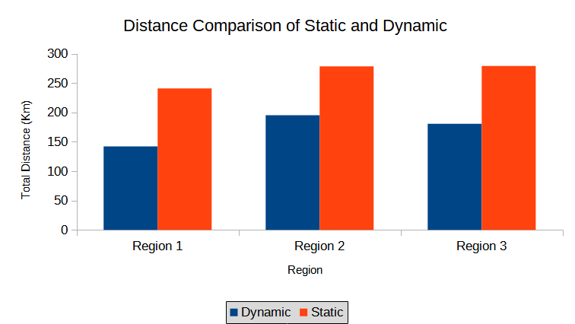
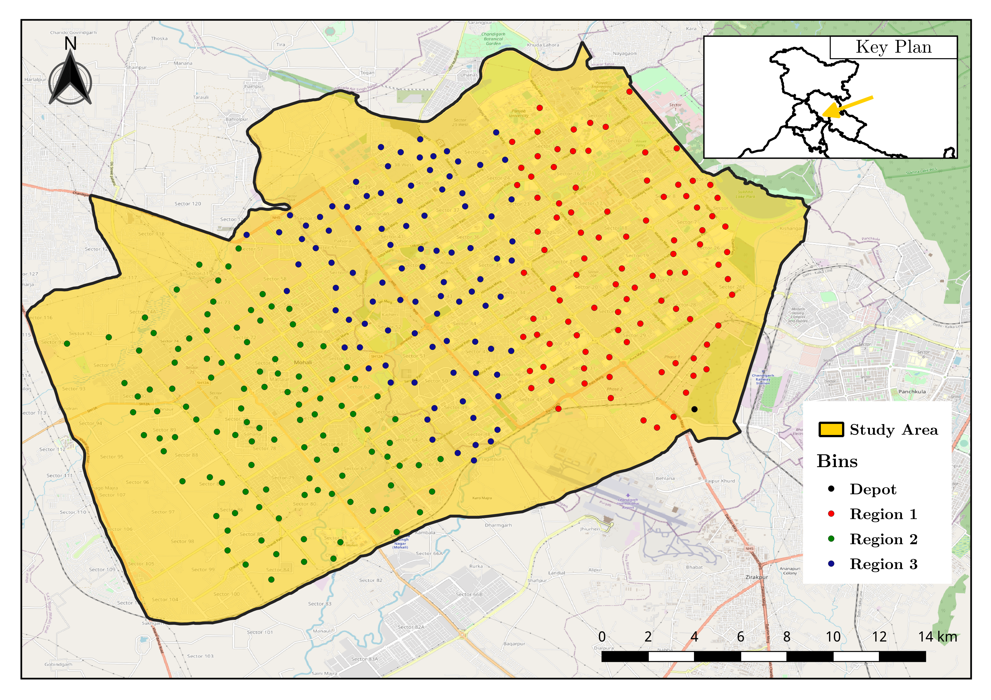
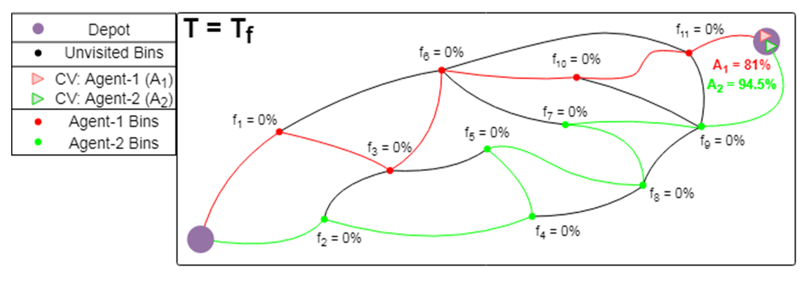
Dynamic Routing for Efficient Waste Collection in Resource
Constrained Societies
Marut Priyadarshi¹, Meet Maratha¹, Mohammad Anish², Vaibhav Kumar^{1*}
¹Department of Data Science and Engineering, Indian Institute of Science Education and Research Bhopal, India
²Department of Physics, Indian Institute of Science Education and Research Bhopal, India
Motivation
Results
Solid Waste Management (SWM) is considered as one of the critical drivers of urban environmental management systems. India alone produces about 42.0 million tons of municipal solid waste.
Waste collection is the most integral activity of SWM. However, the waste collection in developing countries like India is very unorganized.
This study focuses on providing an improvement over the currently used methods. A more efficient method would also decrease the operational cost of the process, which is another important consideration for a developing nation.
The model was able to successfully distribute the insufficient resources in the most optimal way.
The previous scenario was extended to estimate the minimum number of CVs required to satisfy the demands of the whole city.
This enables stakeholders to get an idea about the costs needed to fully service a region.
Research Objectives
Waste collection infrastructure consists of many interdependent parts and elements that allow it to function as one cohesive system. But the system, has many points of failures and inefficiencies. These are even more severe for developing nations.
This study aims to bring significant improvements to the performance of the systems currently in place.
While proposing the changes to the current system, the feasibility of its on-ground implementation also had to be taken into consideration.
These changes, on a secondary level, would have a positive impact on the environment as well.
From a sanitary standpoint, efficient waste collection would also benefit public health.
Routes generated by static model
Routes generated by dynamic model
The currently implemented static waste collection system was compared to this study’s dynamic real-time model.
It was observed that the model was able to collect the same amount of waste while reducing the total distance traveled by up to 45%
Methods
The set of nodes for the city of Chandigarh were generated using QGIS.
The nodes are then divided into 3 regions by using k-means clustering technique.
The nodes were treated as Internet of Things (IoT) enabled smart bins.
A multi-objective linear programming model for route calculation was formulated.
The model was then solved using Gurobi optimizer for multiple execution cases.
The model was also solved for the scenario where the number of Collection Vehicles (CVs) were insufficient to satisfy the waste collection demands of the city.
Future/Ongoing Work
One of the study’s limitations would be the non-consideration of a bin by any other CV, even if the bin were not full when visited. Simulated smart bins were considered for testing models, which can be replaced with IoT-enabled smart bins in real environments. Further integration of real-time data of accidents, street signage, construction work, etc., can provide more accurate routes.

